Slide 1
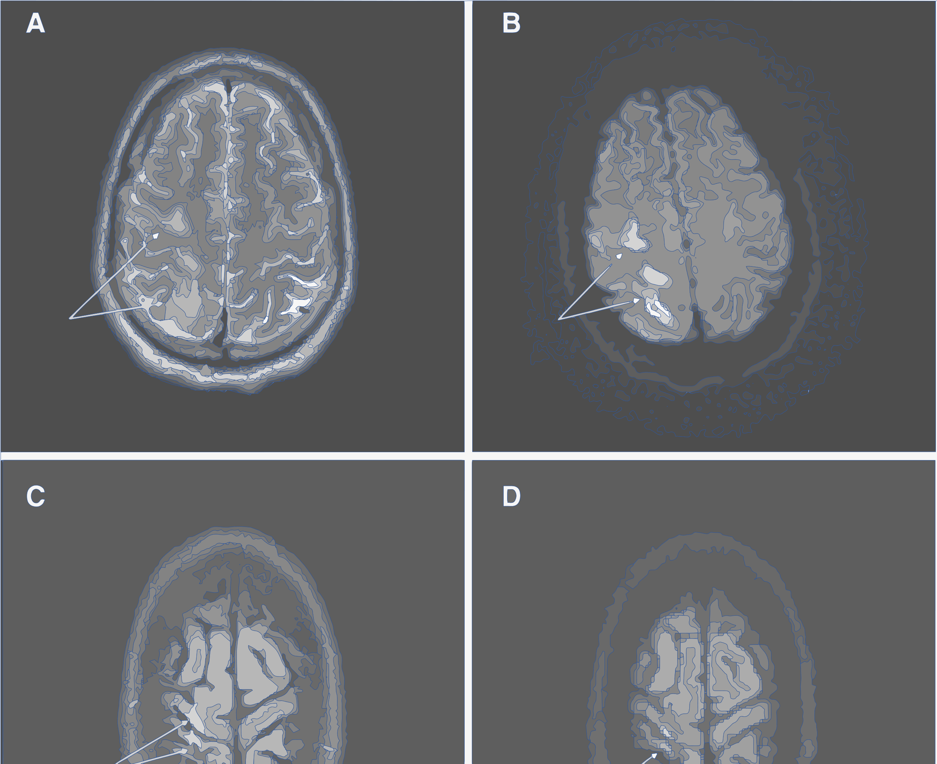
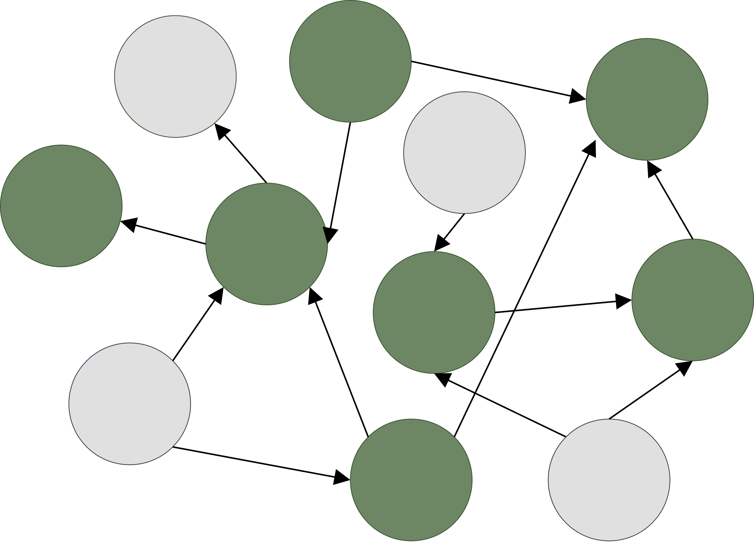
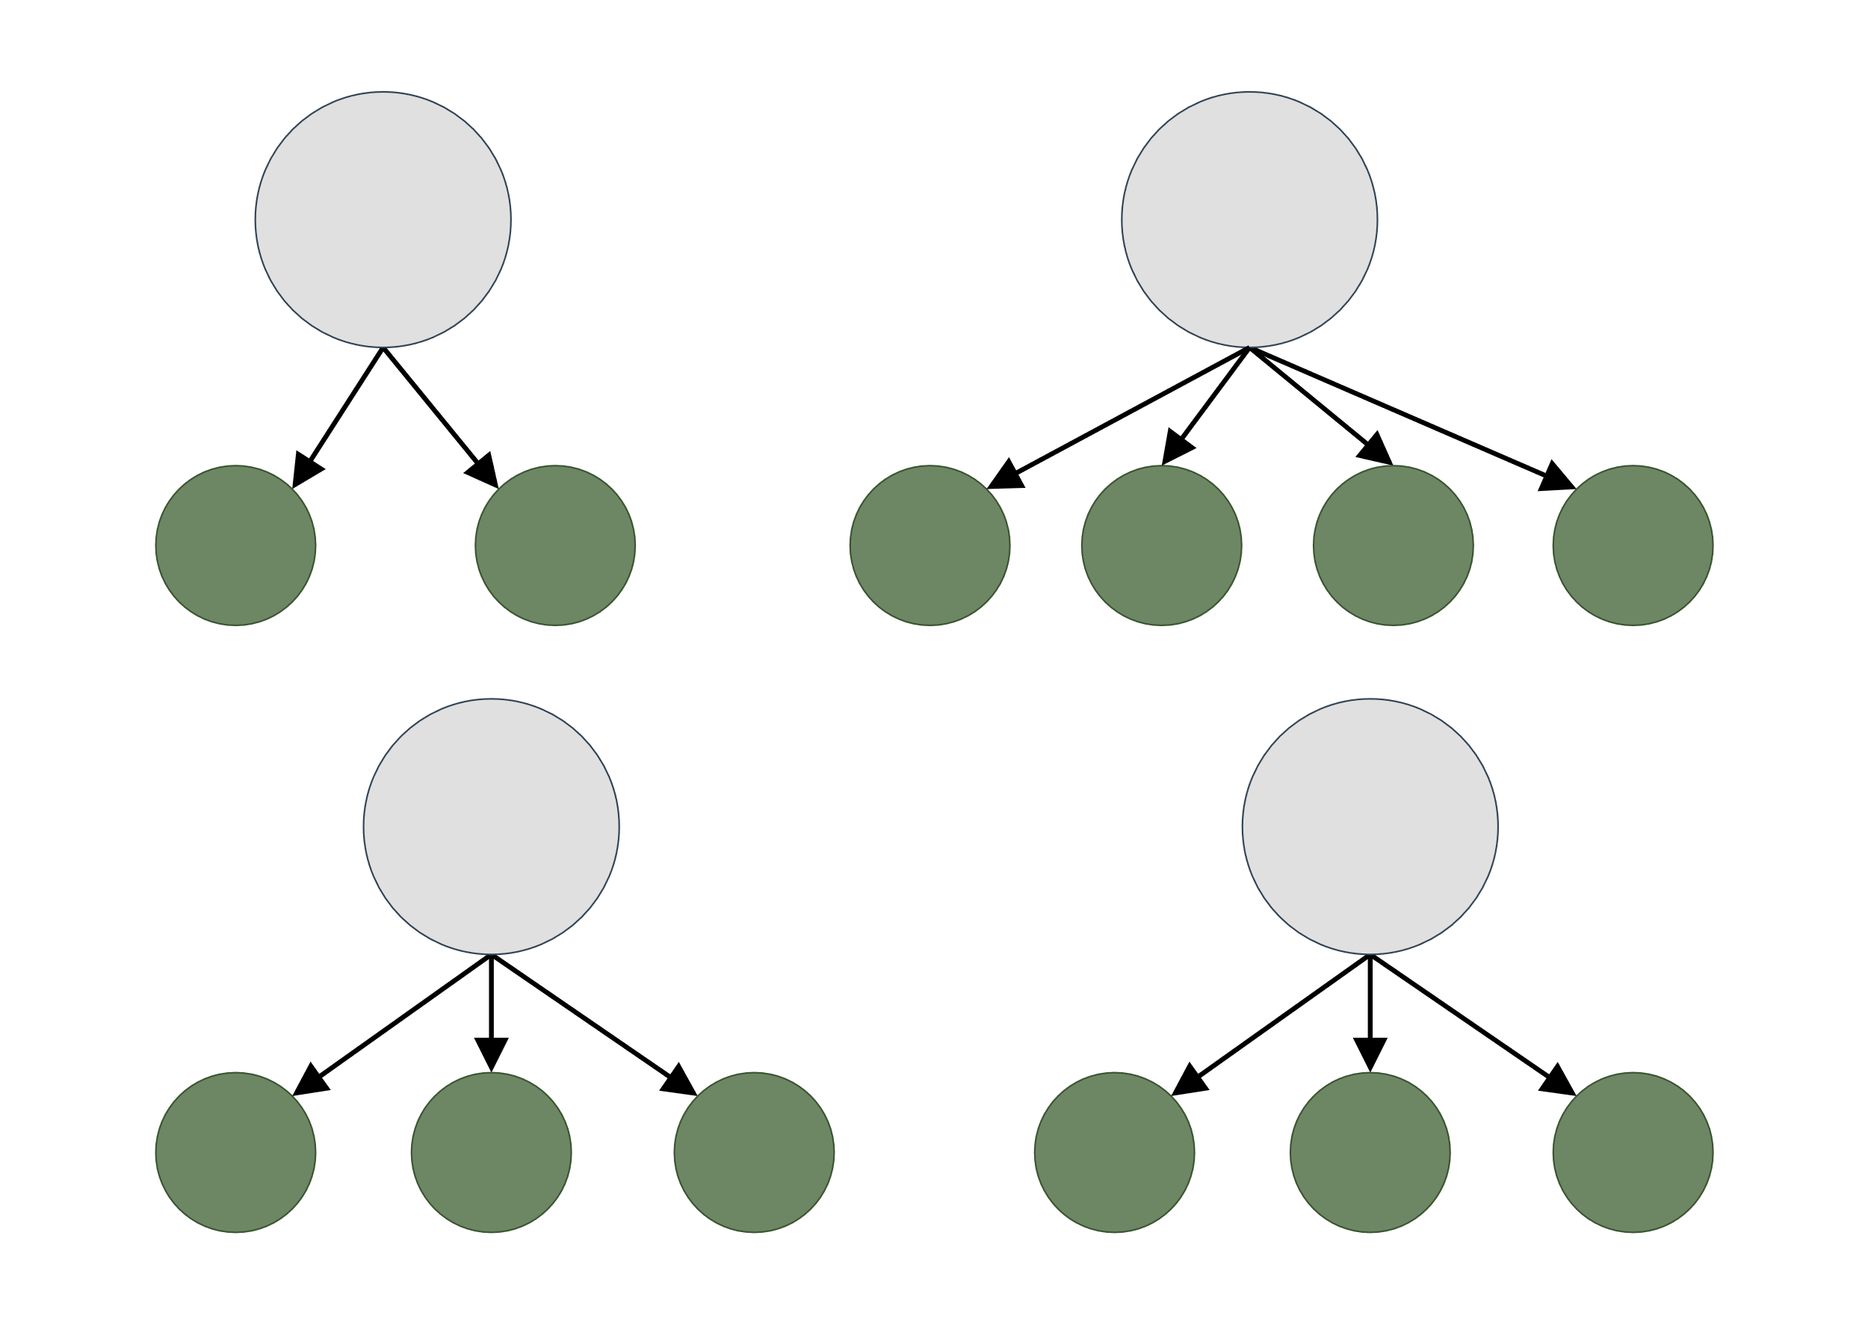
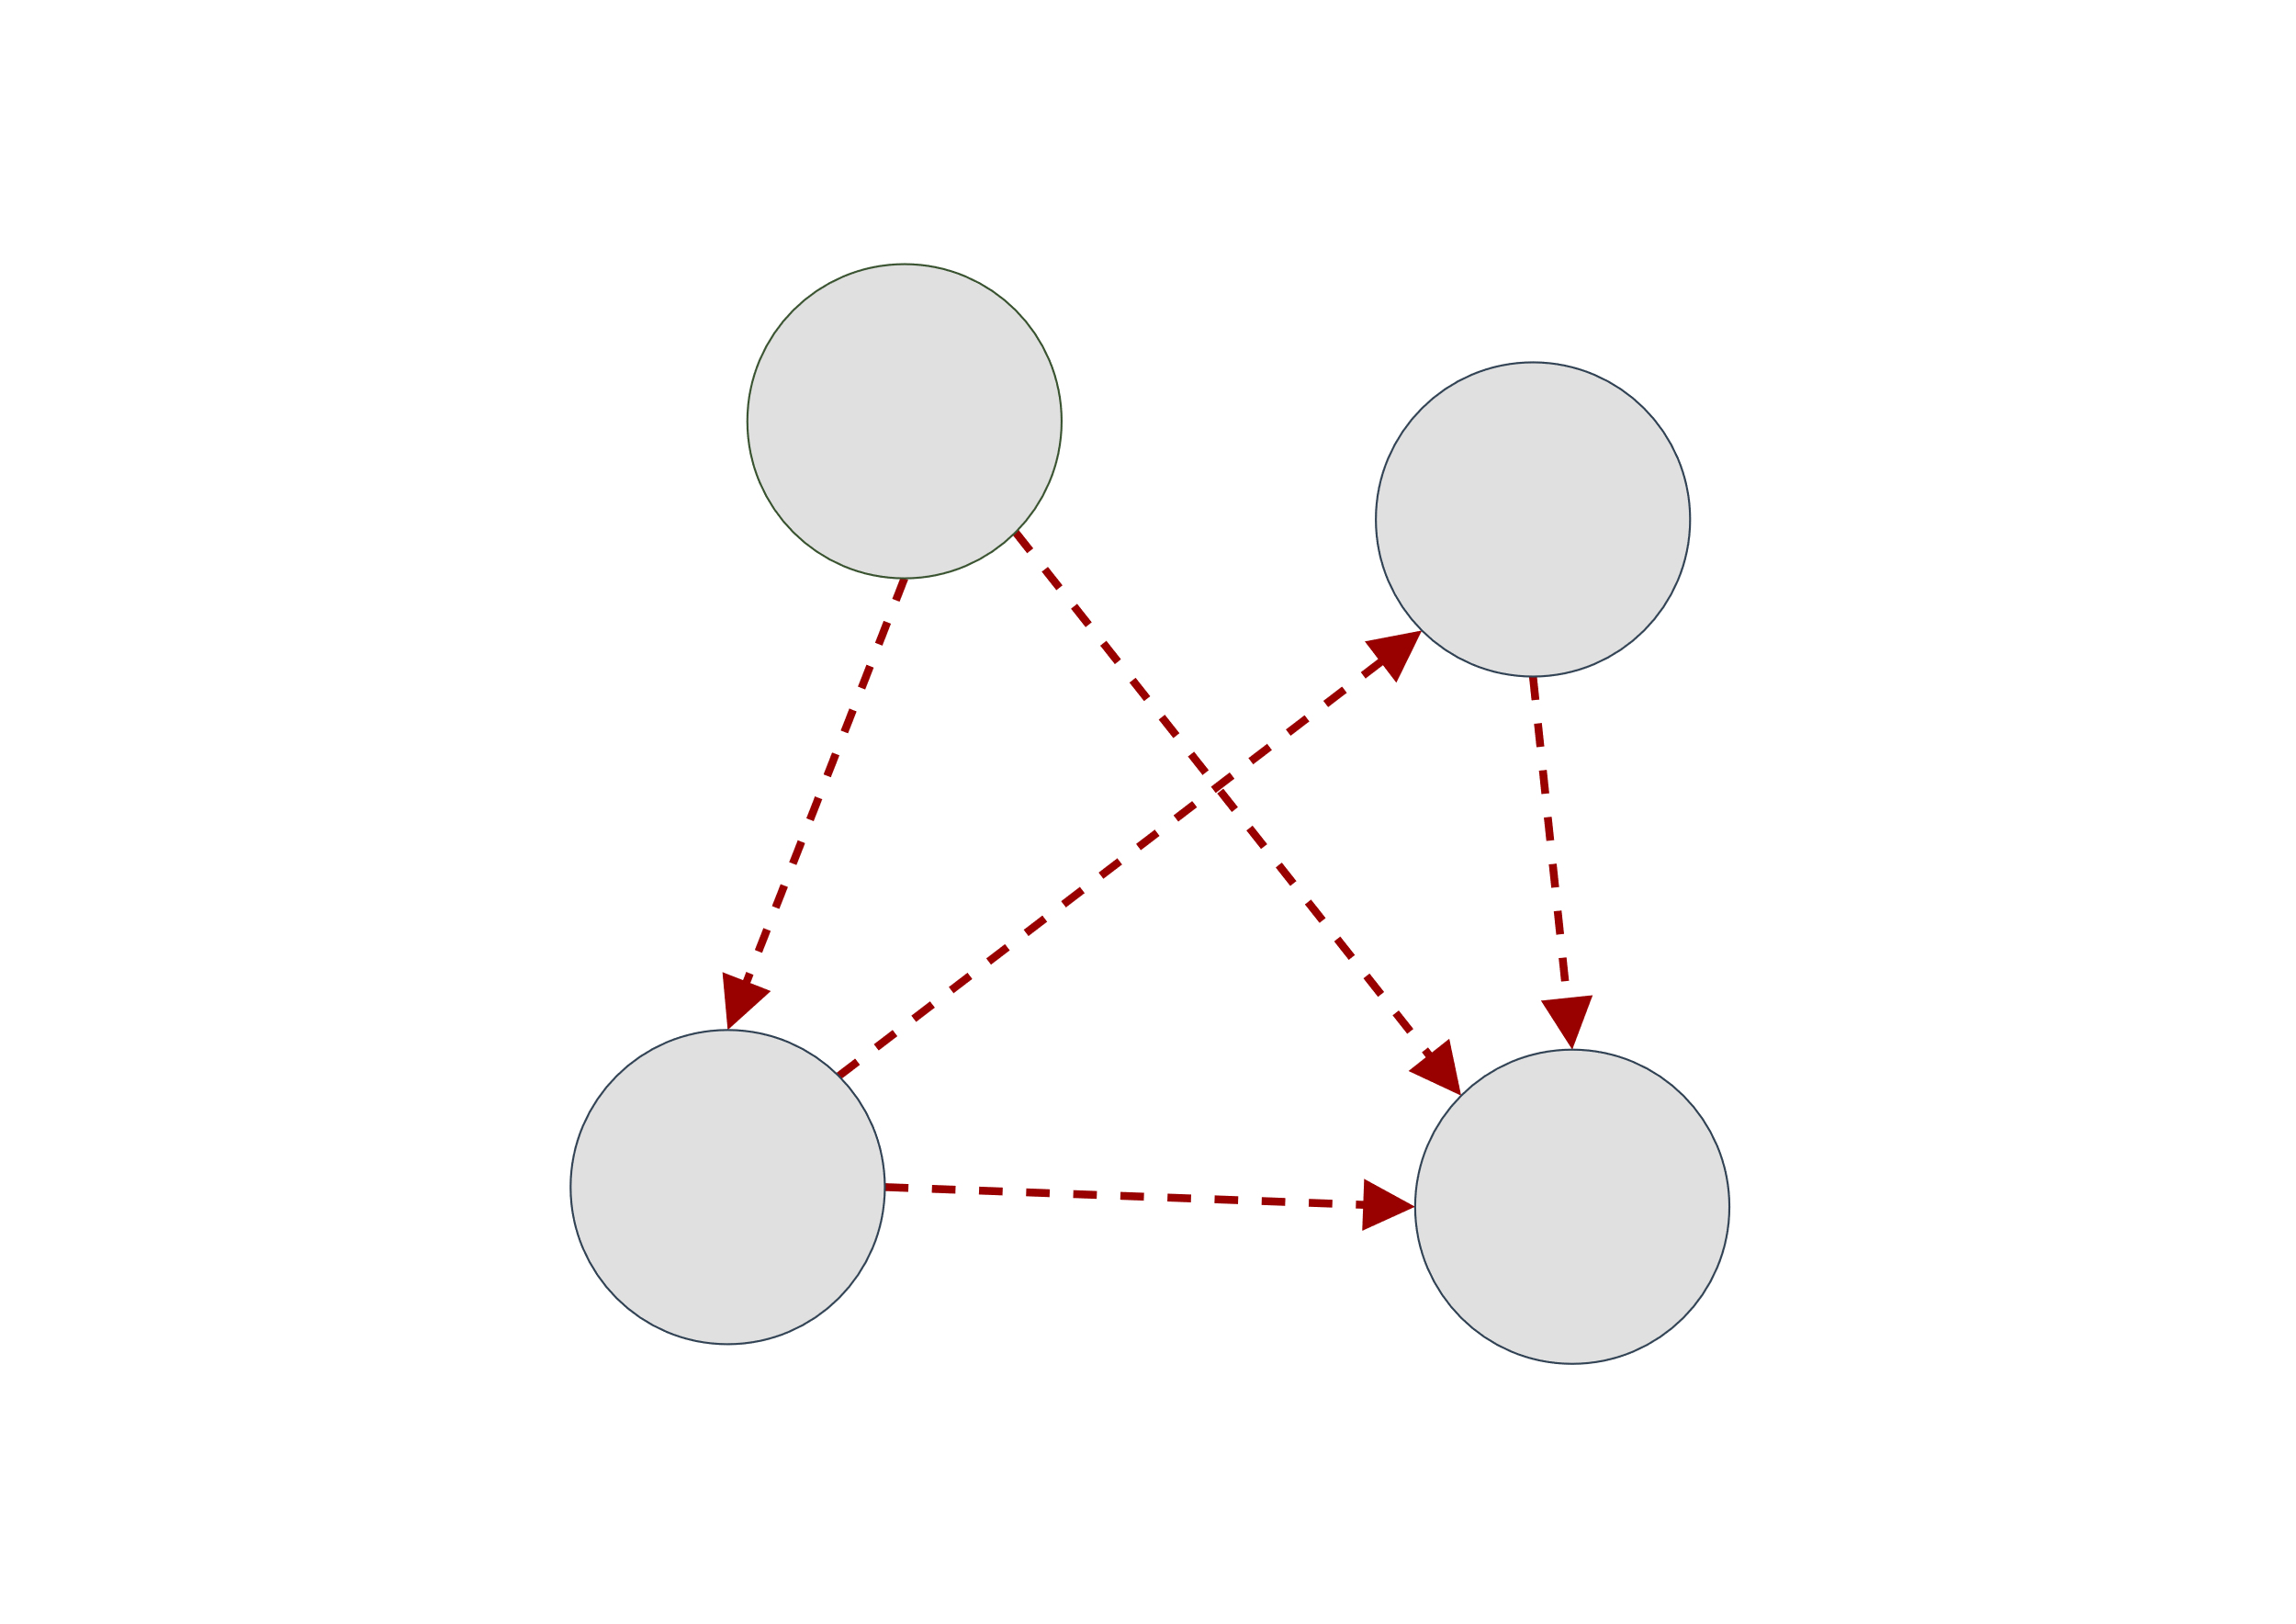
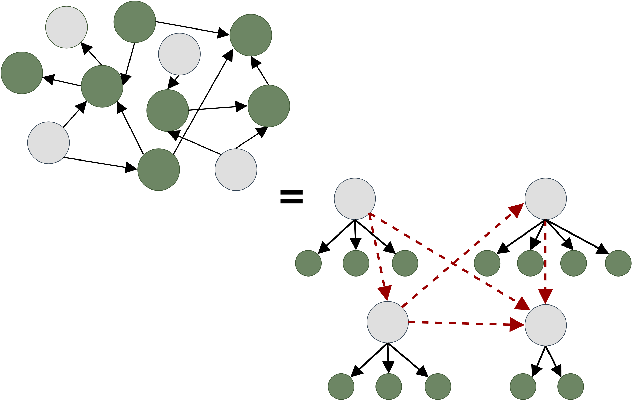

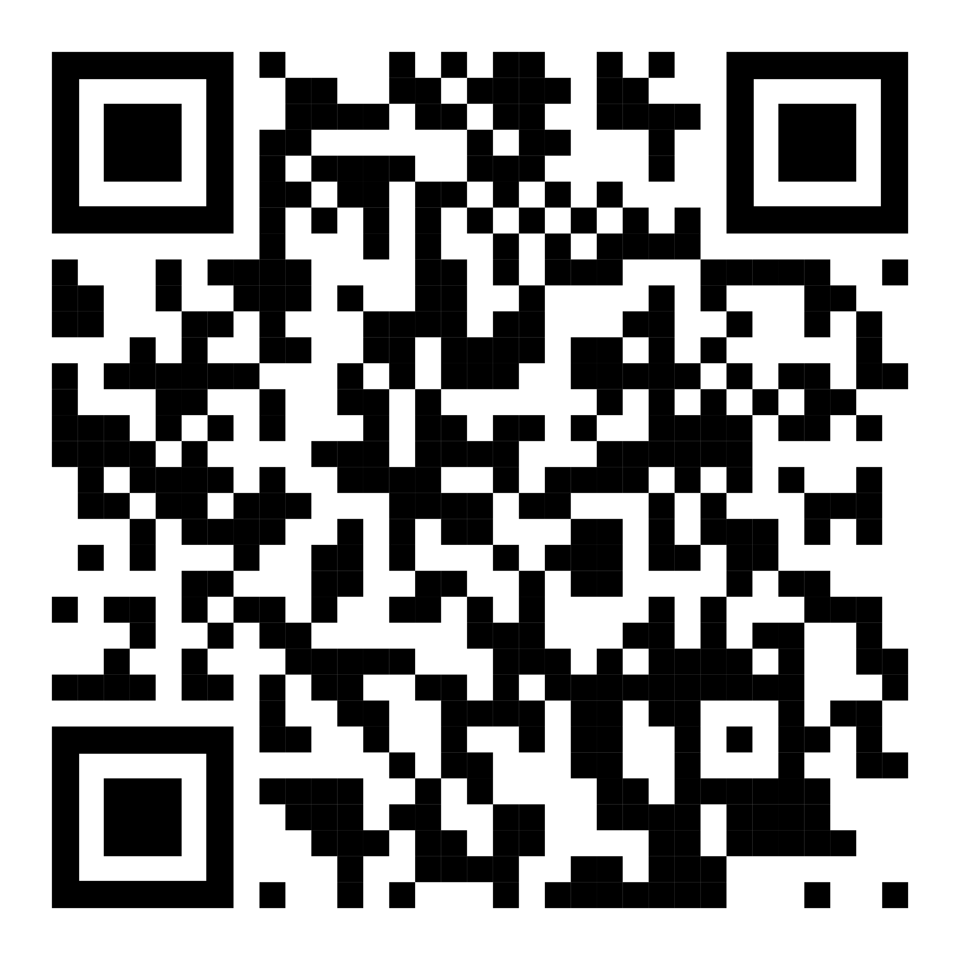
Method
Expectation Maximization and Ensemble Structure Learning in the Presence of Latent Variables
v
v
Proposed underlying true distribution M* as a static Bayesian Network
Latent variables are relearned from the observable data using EM Clustering
USE CASE: The Identification and Progression Tracking of Alzheimer’s Disease
We learn the structure M between latent variables and estimate the parameters
We then compare the learned structure M against M* using KL Divergence
v
v
We want to handle missing or unmeasurable data and uncover the underlying distributional mechanisms that influence observed phenomena. Thus enhancing the interpretability of complex systems, for better informed decision-making and advancing domain-specific knowledge.
EM & STRUCTURE LEARNING IN THE PRESENCE OF LATENT VARIABLES
BY LINDELANI DELISA DLAMINI

